Slide 1




Performance of a Land Use Suitability Model Based on a Deep Feedforward Network in The Leon - Silao
Guanajuato Region
International Conference on Geospatial Information Sciences
Rodrigo Lopez-Farias, Juan Antonio Pichardo-Corpus, Raúl Aguilar Vilchis
October 22-25, 2019

Slide 2

Introduction
Urban growth model simulators are computational land use change (LUC) predictor models used to study the evolution of the spatial urban growth. Several models, use a stochastic land use change urban simulation component which depends strongly on the accuracy of the suitability function. The suitability function estimates the probability of land use change from non urban to urban use for a land area.

Slide 3
Related Work
The experiments in this work are motivated by the work of Pickard et. al. whom presented an accuracy study of different models implemented in open source software that is accessible for practitioners.
The study includes four urban growth models: SLEUTH, LCM, GeoMod and FUTURES.
SLEUTH is a stochastic cellular automaton able to deal with spatial information associated with the slope, land use, exclusion, urban, transportation and hill shading variable, (the initial of each variable gives its name).

Slide 4
On the other hand, the models GeoMod, LCM and FUTURES that were better in predicting the quantity of urban land use change, are more flexible with regards to input data, but less accurate in allocation. These models (except SLEUTH) have in common the implementation of a Linear Logistic Regression for the estimation of land use suitability.
These models also share the use of several components to perform the spatio-temporal prediction task.
This dependency makes important to improve the accuracy of urban suitability to perform more accurate urban simulation since the land use suitability represents an initial probability of land use change for each cell.

Slide 5
Proposal.
A land use suitability model based on a Deep Feedforward Network (DFFN), as a more accurate alternative in comparison with the linear based Multi-level Logistic Regression (MLLR) land use suitability model.
We test the accuracy of both models in a classification experiment performed with georeferenced data from Leon - Silao region located in Guanajuato, Mexico.

Slide 6
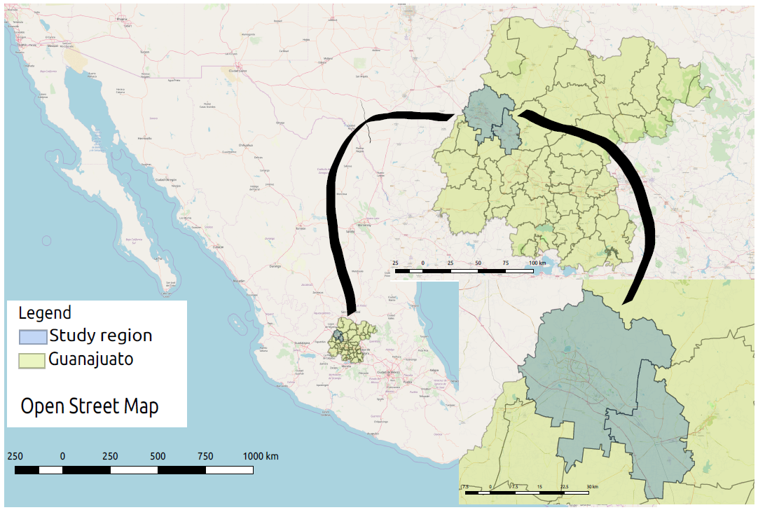
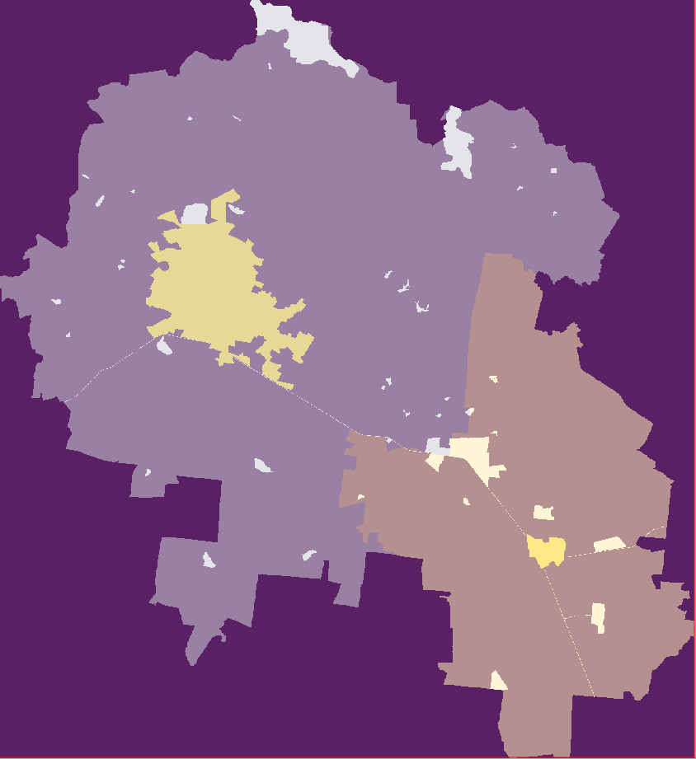
Data Description
The regional data of Leon-Silao municipalities are obtained from open databases hosted by the Institute of Statistics and Geographic Information (INEGI). The data is geographically constrained by the regional boundaries of Leon and Silao municipalities located in Guanajuato State
The resolution of the raster georeferenced map is 30m x 30m per cell.

Slide 7
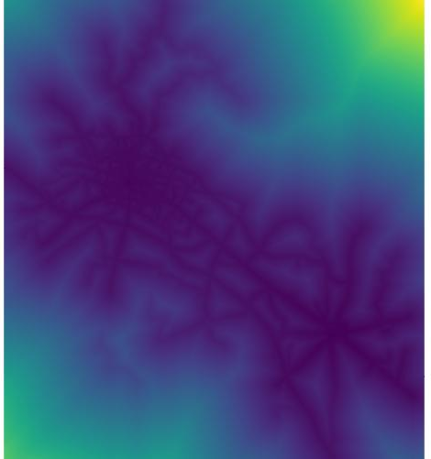
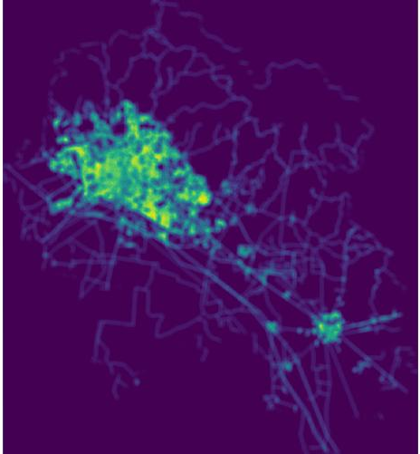
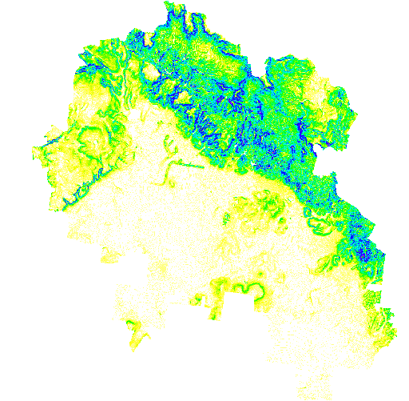
Travel time to the city
Road density
Slope

Slide 8
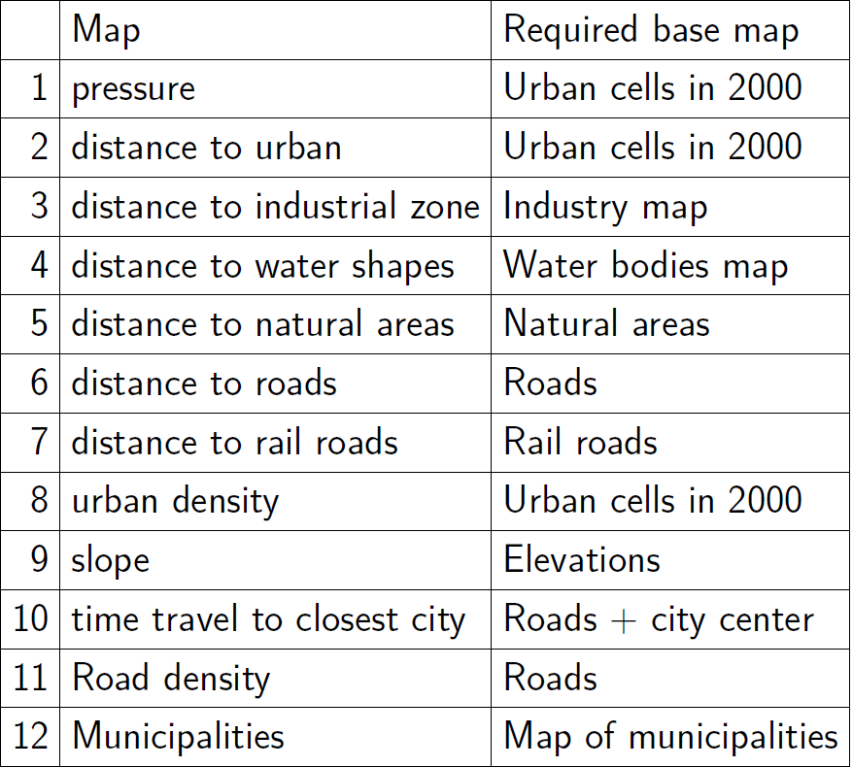
Materials and Methods
Table 1: Maps defining the independent variables.

Slide 9
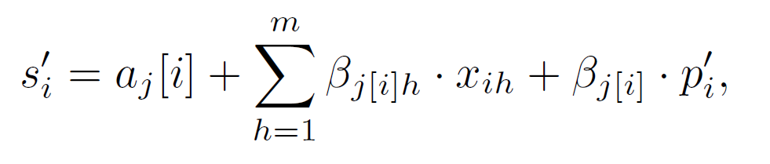
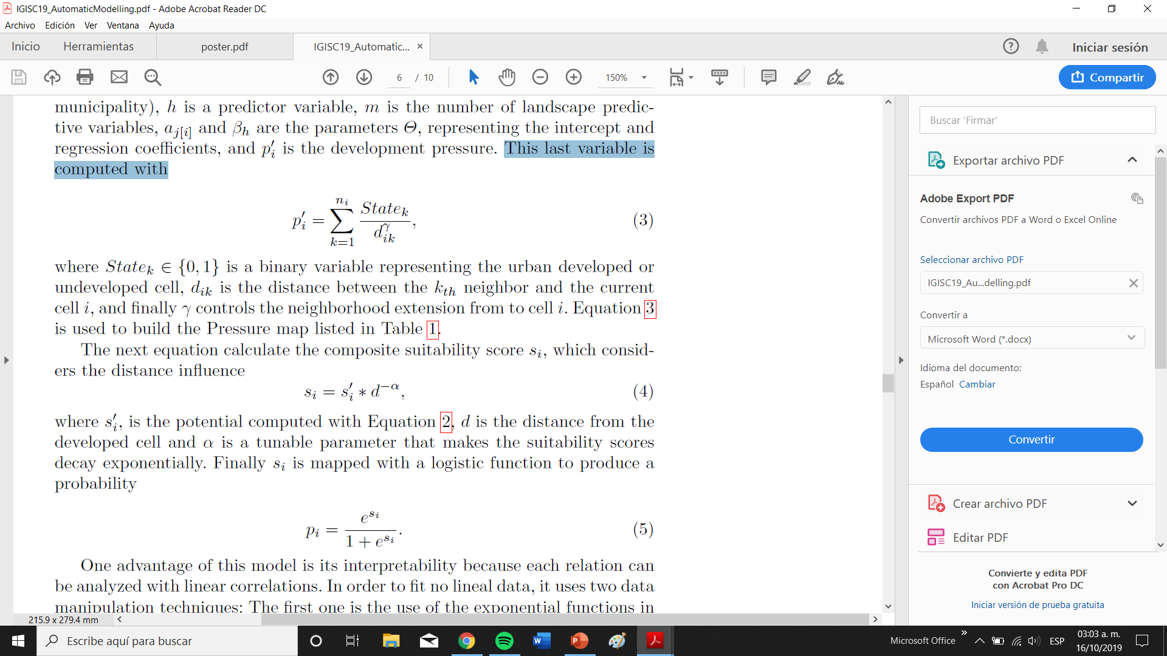
Site Suitability Model based on The Multi-Level Logistic Regression
The core of this Linear Multi-level Logistic Regression model is the regression function

Slide 10
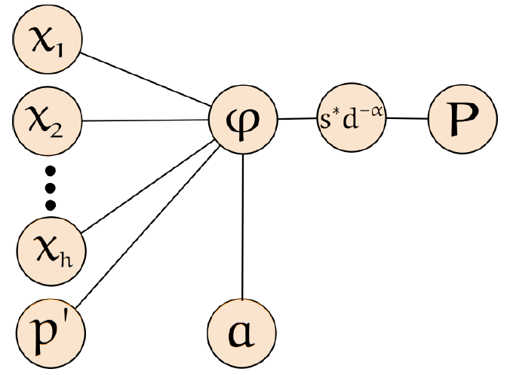
The relation among variables and its processing flow of Equation 1 is described in Figure 1.
Figure 1: Processing flow of the Multi-Level Logistic Regression (Equation 1).

Slide 11
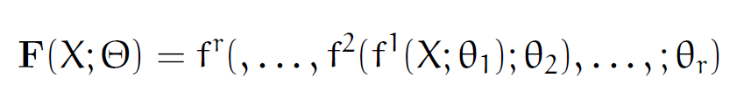
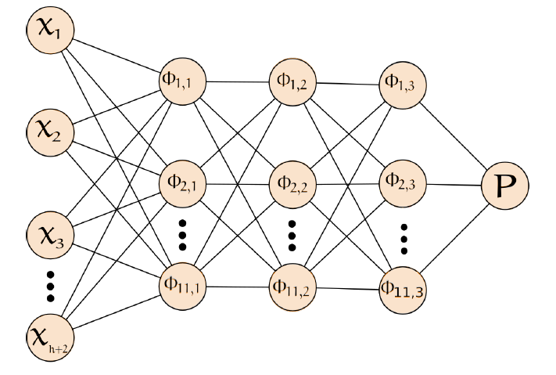
Deep Feedforward Network Model: Deep Feedforward (neural) Networks are computational models inspired in neuroscience. It is a composition of interconnected functions (or layers) where the information flows from input to output through the different layers without feedback. A functional way to describe DFFN is expressed as follows:
A graphical representation of the DFFN is presented in the next Figure:
Figure 2: Processing flow of the Deep Feedforward Network

Slide 12
Experiment and Results
We use the land use change of development detected from year 2000 to 2010. We exclude water bodies, protected natural areas and the already urbanized land. The set is composed by a total of 7,301,093 vectors excluding the development at year 2000, water shapes, natural areas and industrial parks where the urban development is not possible.
In order to select the training set we proceed as follows:
1. We select a random sample with 70% from the set of all vectors class 1 without repetition.
2. To have a balanced sample of classied vectors, we select a random sample of vectors class 0 with the same number of elements contained in Class 1.
3. The remaining data is used as test set, having a test set size of 6,585,741 vectors for DFFN. For MLLR implemented in Futures, the test was performed with the total of the data since the package does not provide functions to identify the data sample used for training.

Slide 13
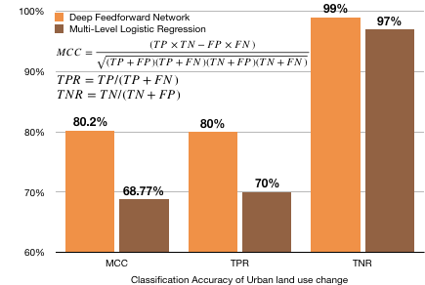
Presents the classification results in terms of Mathews Correlation Coefficient (MCC),True positive and Negative Rate. Values closer to 100% are better.

Slide 14
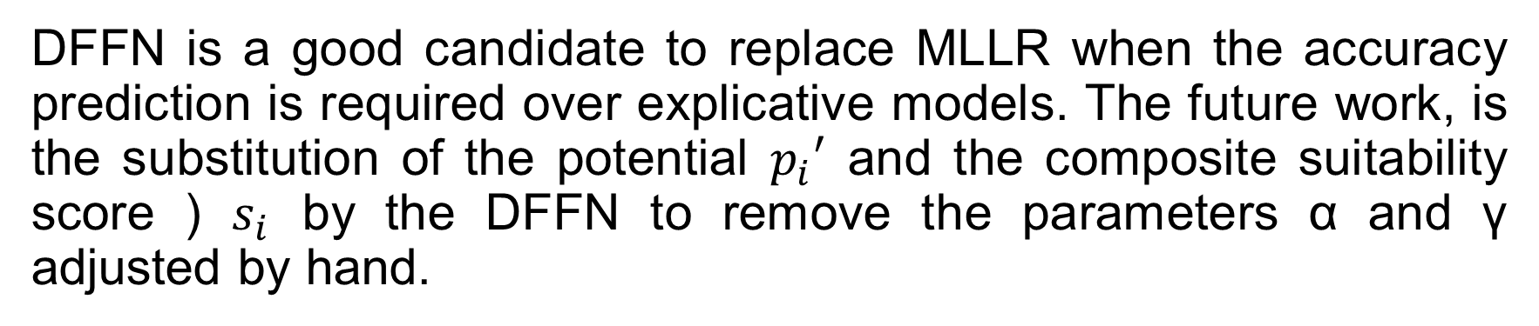
Conclusions
DFFN is a good candidate to replace MLLR when the accuracy prediction is required over explicative models. The future work, is the substitution of the potential $p_{i}′$ and the composite suitability score ) $s_{i}$ by the DFFN to remove the parameters α and γ adjusted by hand.

